Slide 1

Olympic data analysis and prediction system
Pragya Agrawal
(2000100100122)

Slide 2
Problem Statement
Build a project or application that alongside needed general functionalities must leverage data science, machine learning, data analysis, or similar technologies to enhance the Olympic experience, promote engagement, provide valuable insights, or address specific challenges related to the Olympic Games.

Slide 3
Introduction
In this project, we embark on a fascinating journey through 120 years of Olympic history. Aptly named 'Olympic Data Analysis and Prediction,' our platform provides an engaging interface for users to explore favorite athletes, book tickets for upcoming events, and even predict future champions. By examining factors such as age, gender, height, weight, and past medals, we unlock valuable insights to anticipate tomorrow's Olympic stars. Join us as we combine the richness of historical data with the excitement of forecasting the future in the world of sports!

Slide 4
Methodology
1. Data Collection
2. Data Cleaning and Preprocessing
Addressed missing and inconsistent data
3. Exploratory Data Analysis (EDA)
4. Feature Engineering
5. Machine Learning Models

Slide 5
Future Scope
Elevate the project by introducing engaging features such as interactive quizzes and real-time event tracking. Enrich user experience with multimedia content, fostering a dynamic platform. Explore partnerships for live streaming options and integrate a gamified element for user participation. Consider developing a dedicated mobile app for on-the-go accessibility, creating a comprehensive and interactive Olympic exploration experience for users.

Slide 6
Limitations
While our project offers a comprehensive interface for users to explore players, games, and predict future participation, limitations include potential inaccuracies in predictions due to unpredictable factors. Reliability is contingent on the availability and accuracy of historical data. The platform may face challenges in adapting to sudden rule changes or unforeseen events, impacting the precision of participation predictions. Continuous data validation and updates are essential for optimal performance.

Slide 7
Technology Used
1.HTML
2.CSS
3.BOOTSTRAP
4.JAVASCRIPT
5.NODE JS
6.MONGODB
7.MACHINE LEARNING
8.STREAMLET

Slide 8
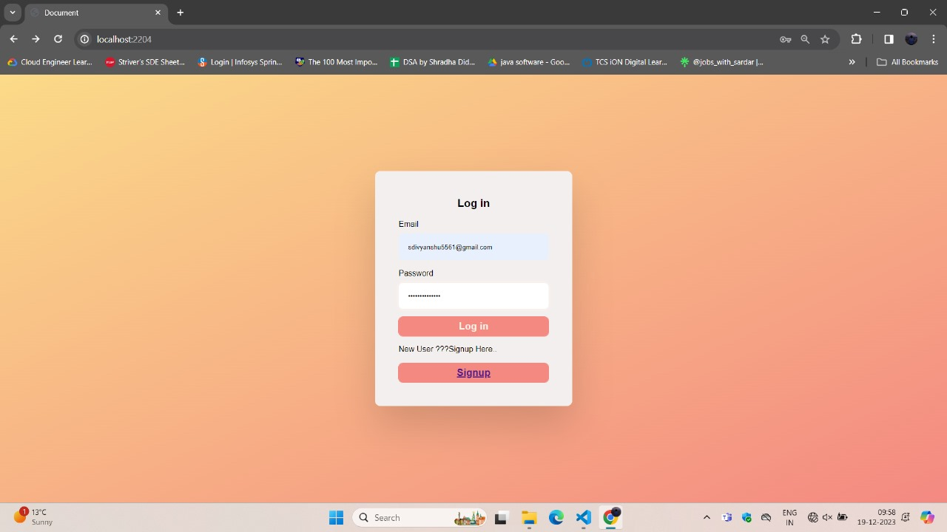
Login Page

Slide 9
Login Page
Welcome to our secure login page for already existing users, where convenience meets confidentiality. Enter your email and password, and with a simple click on the login button, embark on a seamless journey into our platform.

Slide 10
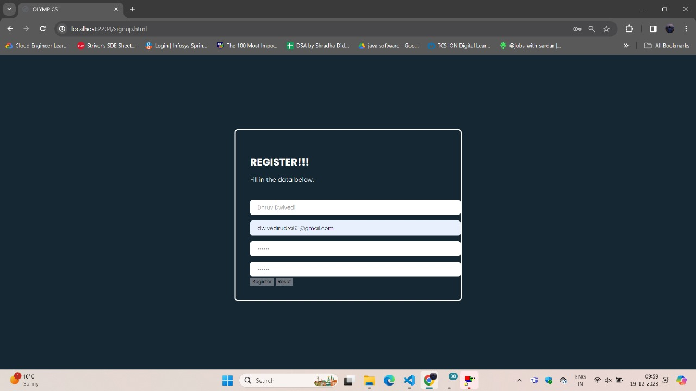
Sign Up Page

Slide 11
Sign Up Page
If anyone is a new user, our user-friendly signup page awaits him/her. Enter your name, email, password then confirm password. A simple click on the signup button is your gateway to seamless access.

Slide 12
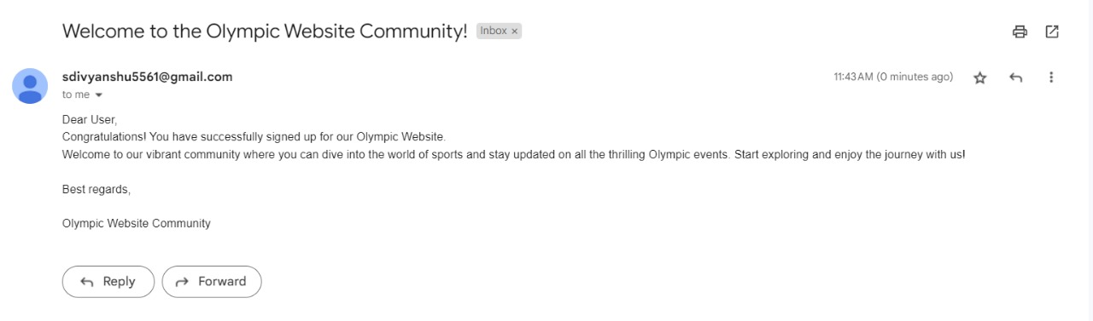
Email Confirmation
Upon successful registration on our platform, users receive instant email confirmation. This ensures a secure and efficient onboarding process, assuring users that their signup details are validated and welcoming them to our community with a confirmation message.

Slide 13
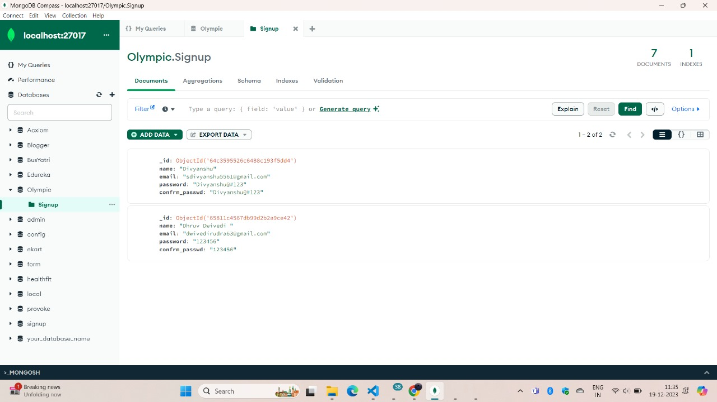
Database
User details entered on the signup page are securely stored in our database. Enhancing visualization, we utilize MongoDB GUI, ensuring a seamless and organized presentation of user data for improved accessibility and management.

Slide 14
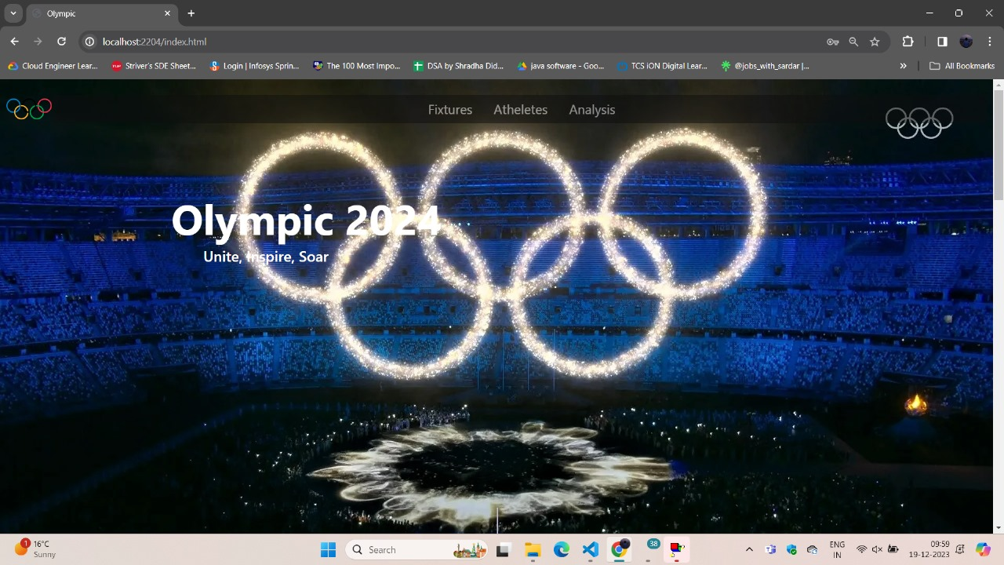
Home Page

Slide 15
Home Page
At the top of our Home Page we have given navigation bar that will redirect users on other related pages of website like fixtures, athletes, login, signup, analysis.
Then we have given a banner image of Olympics 2024 for better visual appeal, creating a narrative that resonates with the audience and communicates the website's purpose.
The website includes a dedicated option for athletes and Olympic games. This feature allows users to access comprehensive information about the various games and their respective sports personalities.

Slide 16
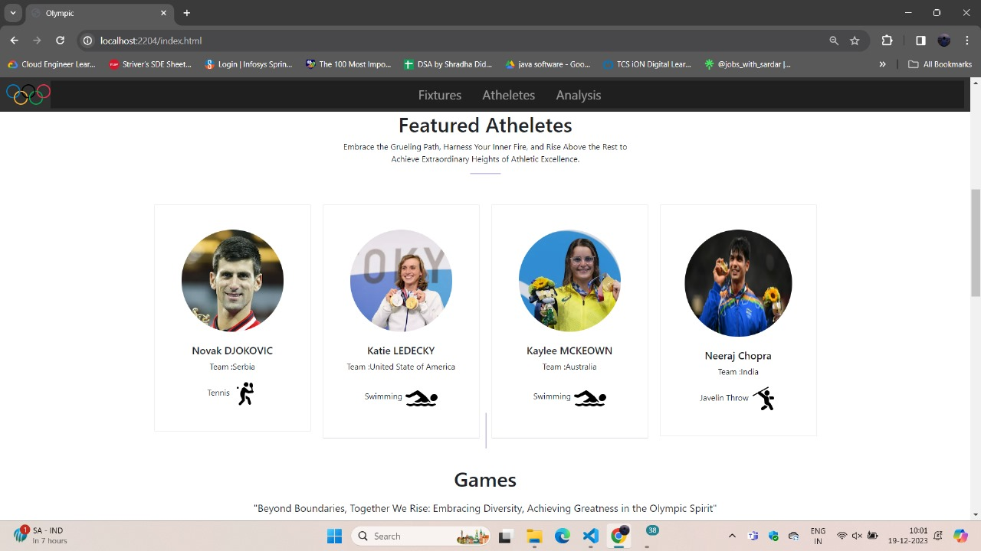
Home Page(Featured Athletes & Games)

Slide 17
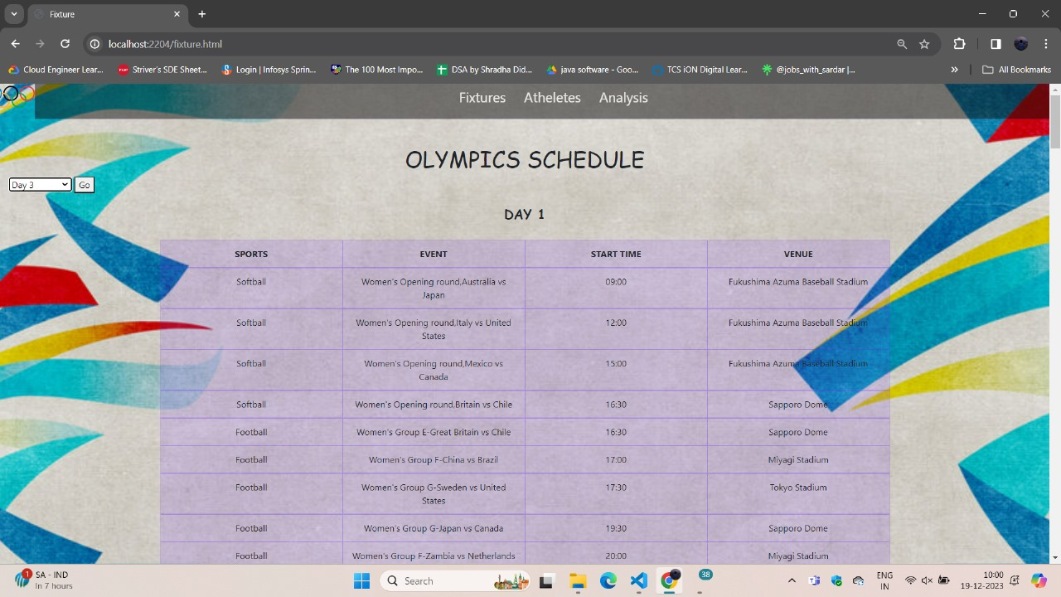
Fixtures Page
Introducing the "Fixtures" page on our website, featuring the comprehensive Olympic Games schedule. Easily navigate through the calendar to check specific day schedules. Stay updated on all the exciting events, ensuring you never miss a moment of the action.

Slide 18
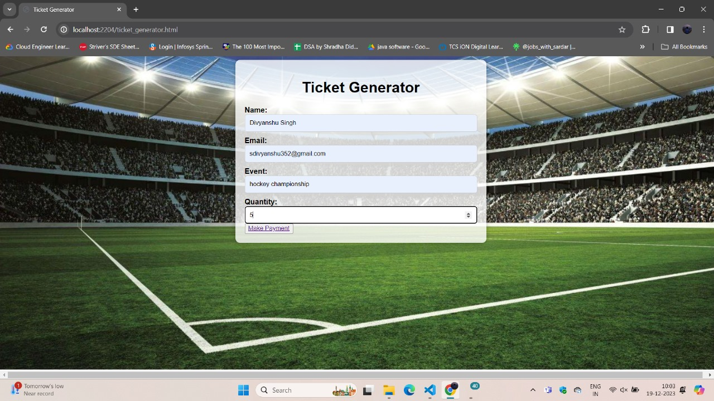
Ticket Generator
Our system simplifies the process. Enter your name, email, select the event, specify ticket quantity, and proceed to payment. Enjoy a seamless ticket generation experience, ensuring quick access to your desired events. Convenience at your fingertips

Slide 19
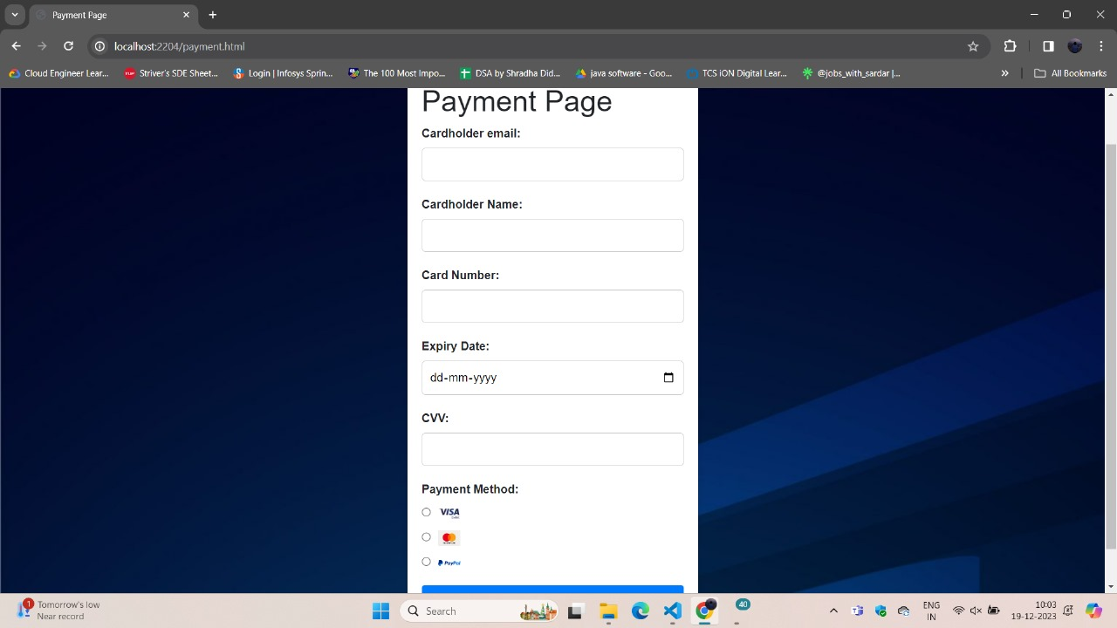
Seat Booking(Payment Page)
Our payment page simplifies Olympic Stadium bookings. Provide cardholder details, card number, expiry date, CVV, select your payment method, and click 'Submit.' Enjoy a seamless and secure transaction, guaranteeing your prime seat for the Olympic excitement!"

Slide 20
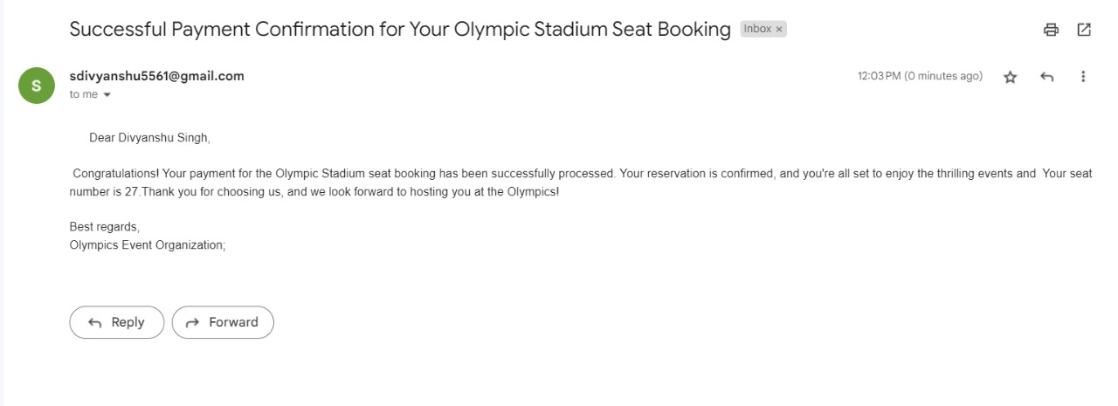
Email regarding seat booking

Slide 21
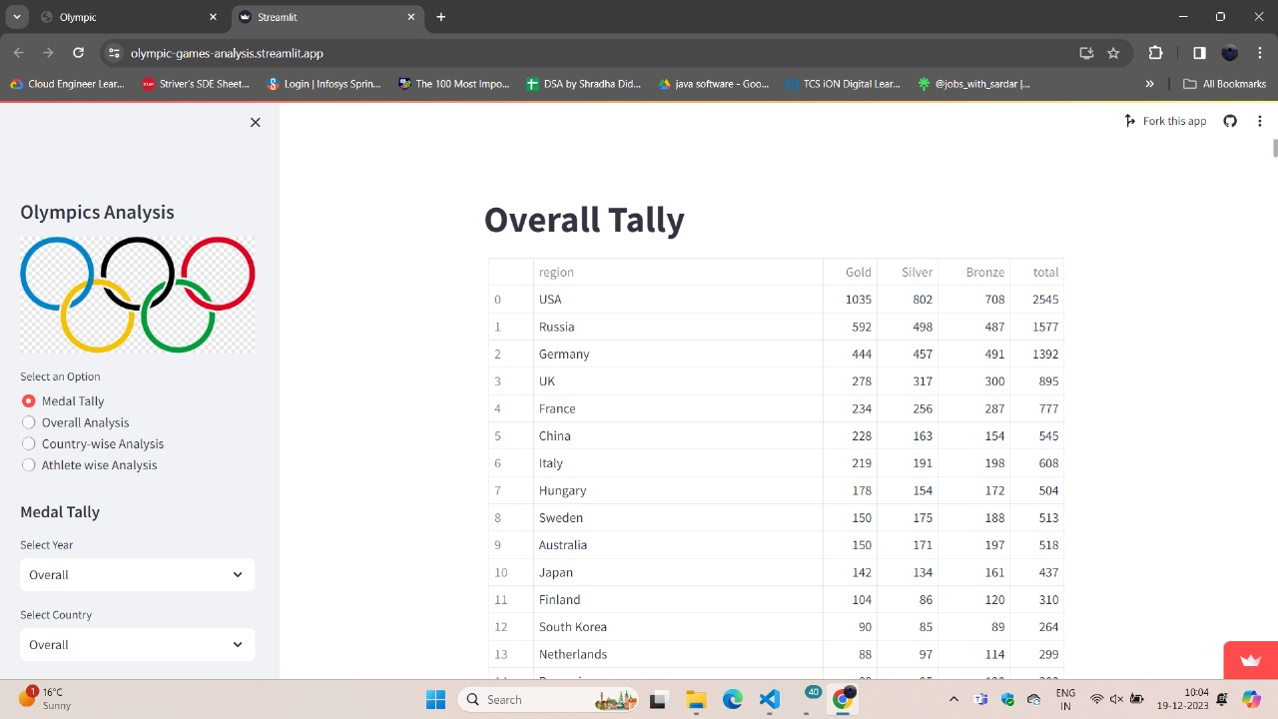
Olympic Analysis Page
Our Analysis Page offers a comprehensive view, featuring medal tallies, overall statistics, country-specific breakdowns, and detailed athlete analyses. Uncover the data-driven stories behind the games and gain a deeper understanding of Olympic achievements and performances

Slide 22
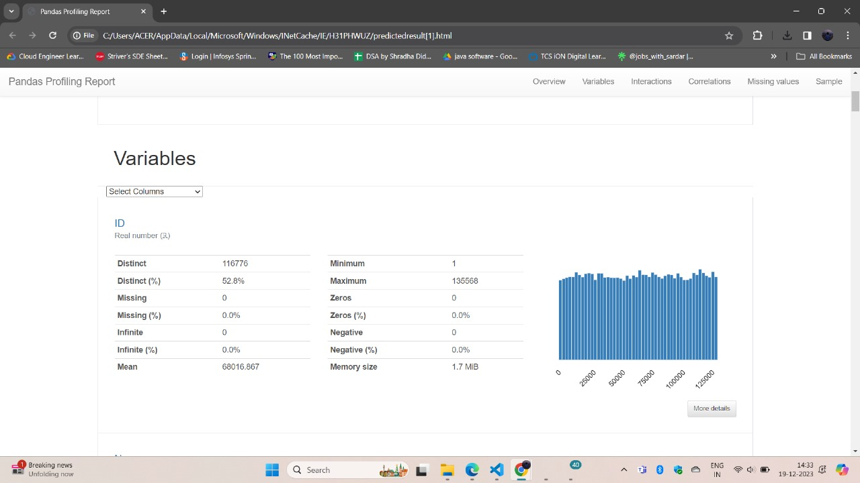

Prediction
Utilizing 120-year-old data, our predictive model forecasts gender participation within specific age ranges for the upcoming year based on factors like age, height, and weight. Recognizing historical trends and considering ethical implications, the model aims to contribute insights into societal dynamics. Continuous feedback, sensitivity analysis, and transparent communication strategies ensure the model's adaptability and practical applicability.

Slide 23
Team Members
Team Member Name1: Divyanshu Singh
University Roll no.:2000100100064
Section/Year:7A/4th year
Team Member Name1: Pragya Agrawal
University Roll no.:2000100100122
Section/Year:7A/4th year
Team Member Name1: Charu Shukla
University Roll no.:2000100100053
Section/Year:7A/4th year
Team Member Name1: Anjali Kushwaha
University Roll no.:2000100100028
Section/Year:7A/4th year
Team Member Name1: Dhruv Dwivedi
University Roll no.:2000100100062
Section/Year:7A/4th year

Slide 24
Thank You

